Slide 1



the fall of the monolith
cloud native design, domain driven design & microservices
Notes:
Resting slide on screen before you begin presenting.

Slide 2
Agenda
Rise and Fall of the Monolith
Domain Driven Design
Cloud Native
Rise of the Microservice

Slide 3
Forces
Team of developers working on a project
New team members must be productive
Application must be easy to understand and modify
Scale up - scalability, availability and resiliency

Slide 4
Solution
Multi-module packaged in single WAR or even EAR
Single directory hierarchy
N-Tier Architecture
Layered Architecture

Slide 5
Resulting Context
Complexity becomes the enemy
Overloaded web container
Continuous delivery becomes burdensome
Scale out
Technical debt
Domain specificity
Notes:
Interdependencies between modules. how does one un ravel? How to upgrade versions of frameworks? Handle dependency management?
Out of memory exceptions and container or JVM tuning
To update one component you have to redeploy the entire artifact, what about container startup – minutes to 10’s of minutes
Scale out is an all or nothing proposition – why can’t I just scale out the service that needs to scale?
Long-term commitment to a technology stack – how to we upgrade Java5 to Java6
Really what is my domain, is there any specificity anymore?

Slide 6
So you have a Monolith, now what?

Slide 7
What is the methodology for designing a microservice?
How to break up a monolith?
What are the design patterns?

Slide 8
Fall of the Monolith
Domain Driven Design
Cloud Native Design
Microservices

Slide 9
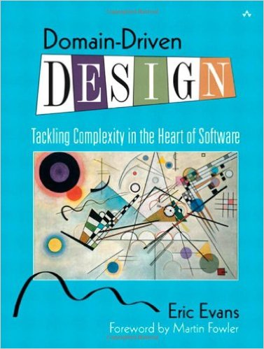
Domain Driven Design
An approach for designing software system that model the complexity of the real world
Kicked off in 2004 by Eric Evans
A practical microservice design methodology

Slide 10
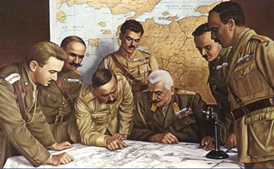
Strategic Domain Driven Design
Domain
Sub-Domain
Bounded Context
Ubiquitous Language
Context Map
Notes:
Picture from http://www.quikmaneuvers.com/principles_of_strategy.html need to check on license rights

Slide 11
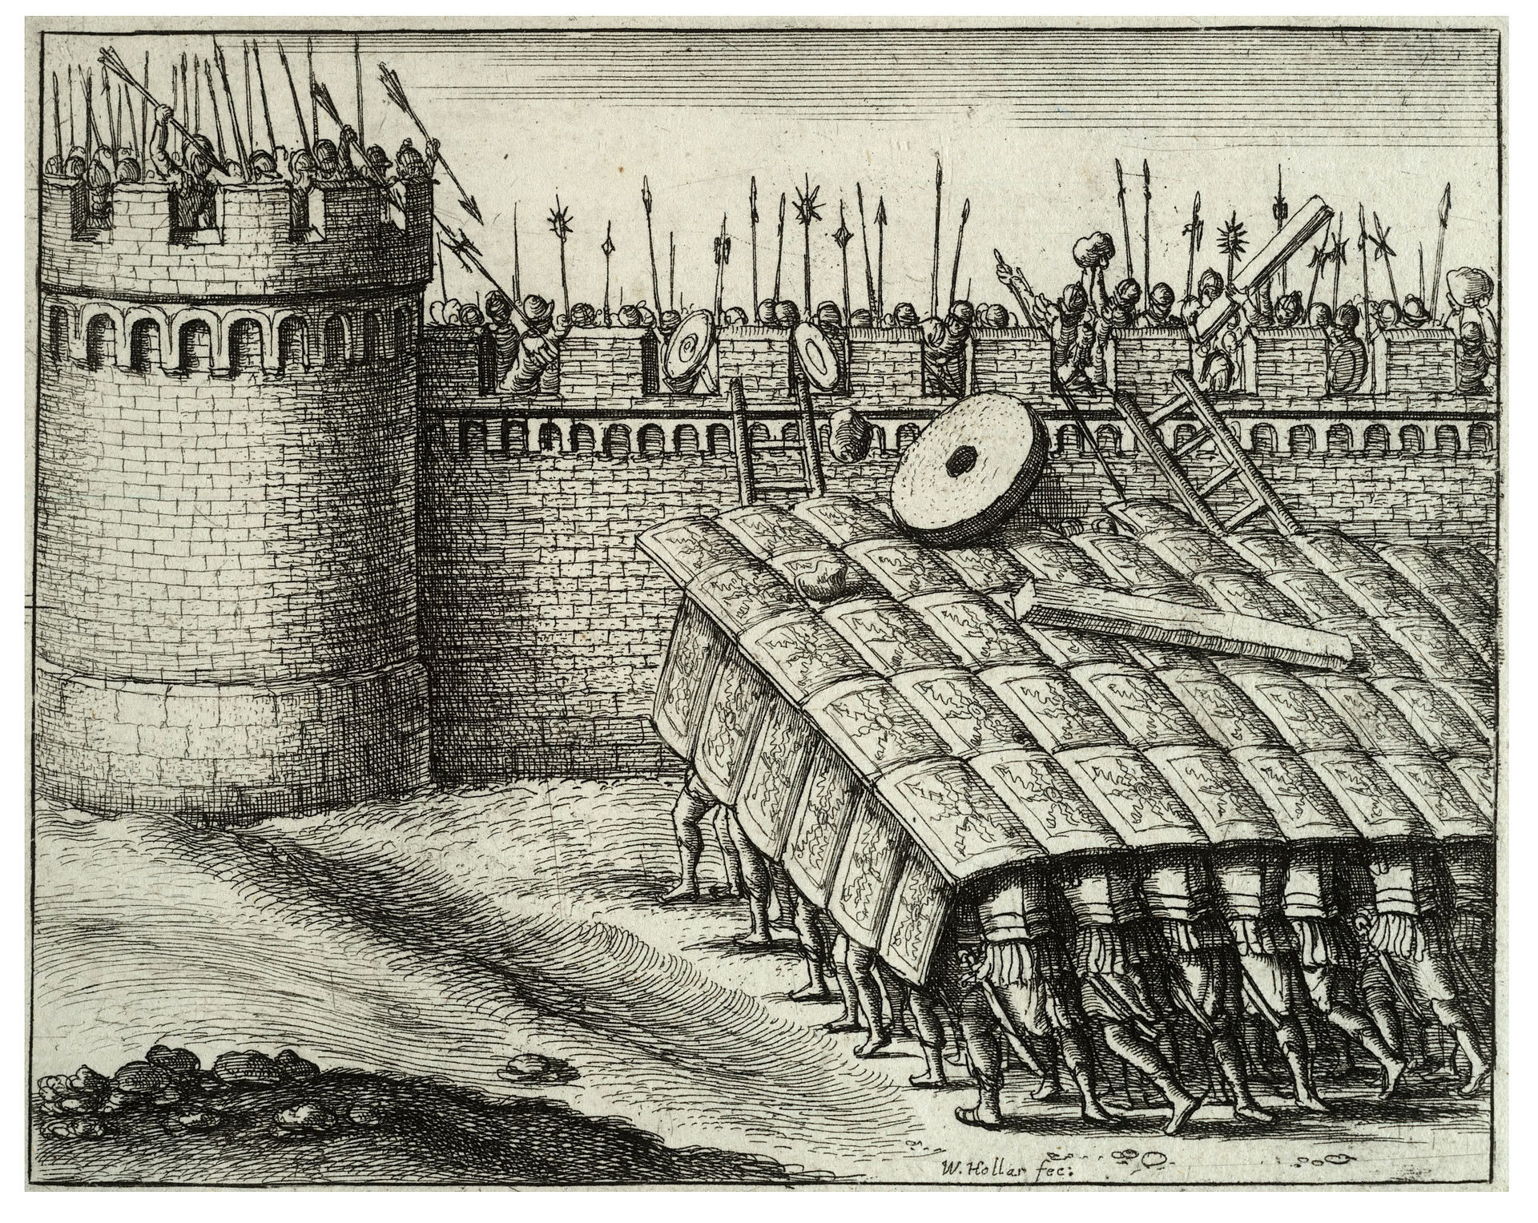
Tactical Domain Driven Design
Entities
Value Objects
Aggregates
Services
Modules
Factories
Repositories
Notes:
Public domain photo https://en.wikipedia.org/wiki/Testudo_formation#/media/File:Wenceslas_Hollar_-_A_testudo.jpg

Slide 12
Domain
Domain is always organization specific
Captures unique know how and way that an organization does business
Composed of sub-domains & bounded contexts

Slide 13
Sub-Domains
Core
Subdomain
Supporting
Subdomain
Generic
Subdomain
Build It Perfectly
Build It
Just enough
Buy It

Slide 14
Bounded Contexts
Banking Context
Security
Context
Account
Account
Account

Slide 15
Ubiquitous Language
Technical Jargon
Business Jargon

Slide 16
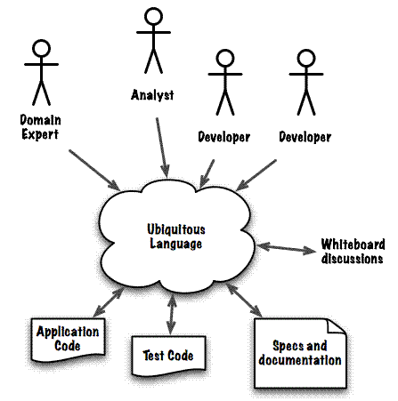
http://www.infoq.com/articles/ddd-contextmapping

Slide 17
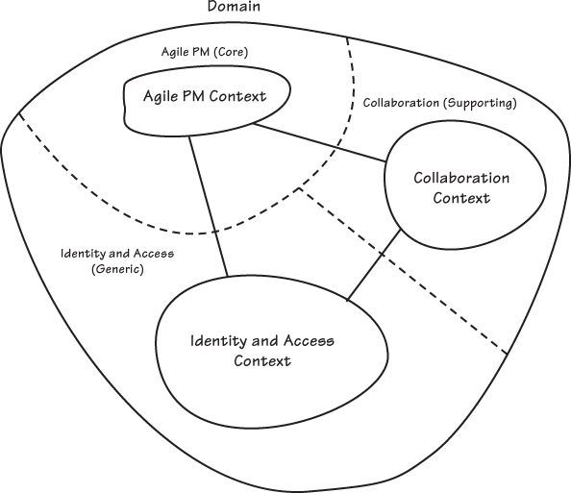
Solution
Figure 2.7 from Implementing Domain Driven Design

Slide 18
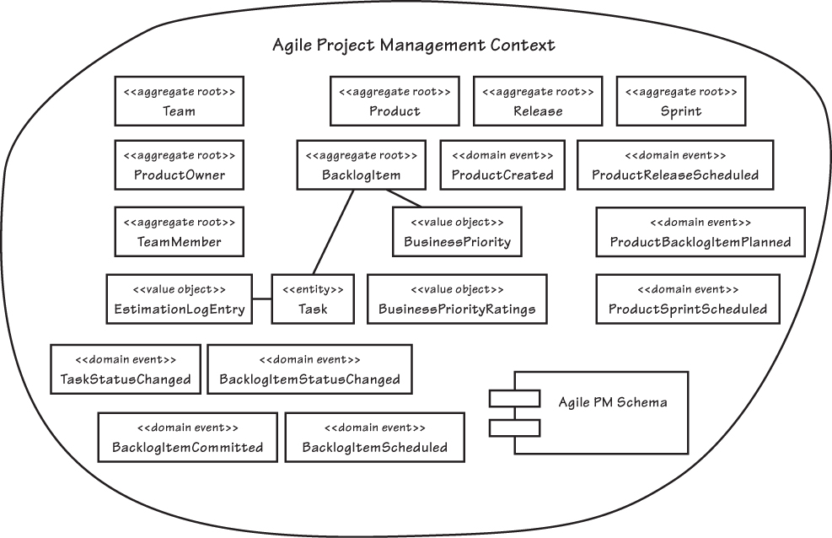
Example Bounded Context
Entities
Domain Event
Value Objects
Aggregates
Services
Modules
Factories
Repositories
Notes:
Figure 2.10 from Implementing Domain Driven Design

Slide 19
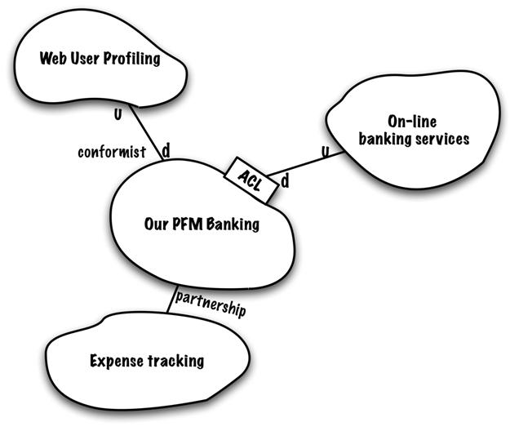
Context Maps
A map of the existing organization & integration relationship between different bounded contexts
Partnership
Shared kernel
Customer-supplier development
Conformist
Anti-corruption layer
Open host service
Published language
Big ball of mud

Slide 20
Cloud Native Design
Evaluate components for 12-factor compliance
Evaluate components and architecture for Cloud Native Design
Standalone services
Common services

Slide 21
Evaluate for 12-Factor Compliance
no file based access to resources
run code on demand
coordinate cross service configurations
route public requests
read and write persistent data
add and remove resources
record internal and external events
isolate resources and failures
measure performance and health
detect and determine failure (plan & provoke failure)
recover failures
work tomorrow

Slide 22
Evaluate for the Cloud
Cloud Native
Micro-service architecture and principles
API first design
Cloud Resilient
Design for failure
Apps are unaffected by dependent service failure
Cloud Friendly
Twelve factor applications
Horizontally scalable
Cloud Ready
Proactive testing for failure
Cloud agnostic runtime implementation
Metrics and monitoring baked in
Leverage platform for HA
No file-system requirements or uses S3 API
Self-contained application
Platform managed ports and addressing
Consume off platform services using platform semantics

Slide 23
Let’s talk about SpringTrader

Slide 24
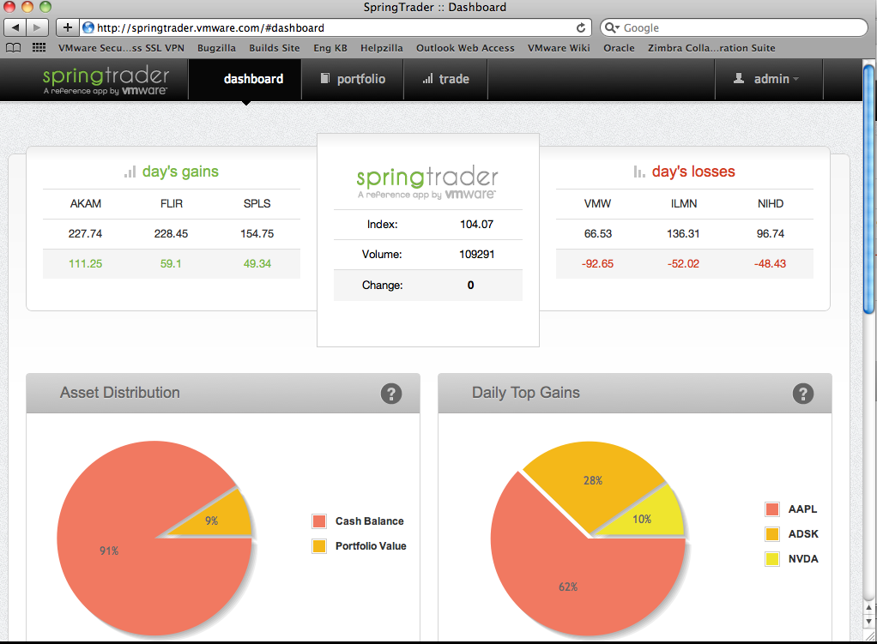

Slide 25
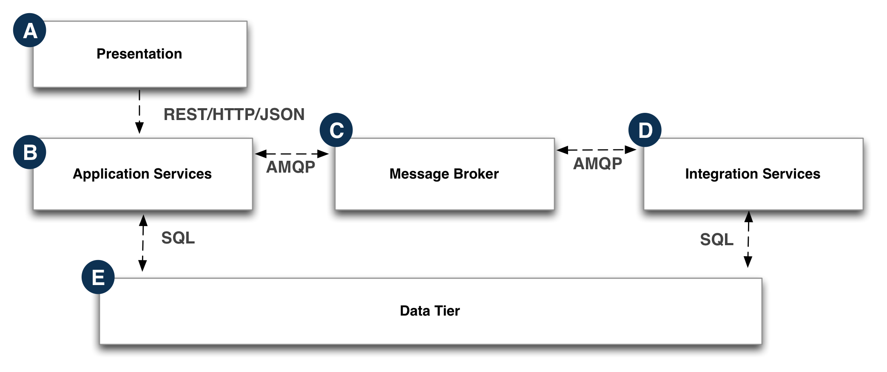

Slide 26
Use Case
if securities are subjected to randomized changes, as if by market forces – wouldn’t it be better to make use of real-time data?

Slide 27
Goals
Replace the existing simulated Quote data with real-time data
Minimize changes to existing code base
Make sure we have a working system when refactor ocfurs

Slide 28
Introduce Microservice
Locate the code
Identify a service interface
Use the proxy pattern
Create an implementation of the interface
Point the monolith to the new service
Notes:
Locate the code that represents the functionality that will be refactored
Identify a service interface that will be the “go-to” for the rest of the monolith
Use the proxy pattern and modify existing code so that it exclusively funnels through this service interface
Create an implementation for the monolith to talk to our new microservice, and provide code to bridge any “impedance mismatch”
Point the monolith to the new service via the new implementation

Slide 29
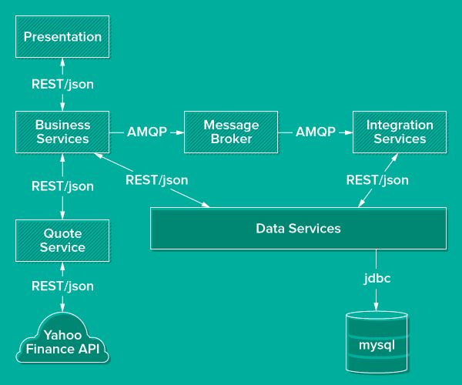

Slide 30
Service Availability
Provide a way to handle failures in remote services
Provide a way to locate and manage loosely coupled services
Make changes while minimizing changes to existing codebase
Make sure there is a working system, are there test to validate

Slide 31
Introduce
Config Server
Service Discovery
Circuit Breaker
Notes:
Service Discovery - we need a simple approach to enable locating microservices by name and at a known catalog endpoint. And use this dynamically at runtime
Circuit Breaker - if a service becomes unavailable, a “fallback method (to an alternative service with similar functionality) can be invoked instead. Normal operations is automatically restored once the failing service is available

Slide 32
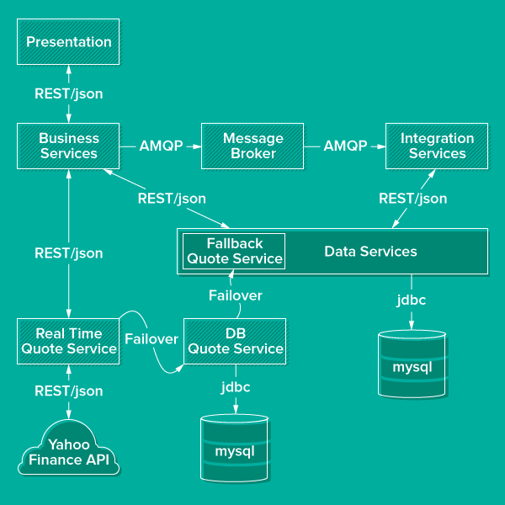

Slide 33
Decompose Further (remember domains)
Use the same technique used on QuoteService to “evaporate” the data modules
Notes:
Service Discovery - we need a simple approach to enable locating microservices by name and at a known catalog endpoint. And use this dynamically at runtime
Circuit Breaker - if a service becomes unavailable, a “fallback method (to an alternative service with similar functionality) can be invoked instead. Normal operations is automatically restored once the failing service is available

Slide 34
Approach
We have interwoven domain models
Domains can be difficult to untangle, but bounded context techniques can help
Quotes: external market events that happened outside the system
Accounts: users of the system, and their profiles
Orders: transactional events acted on by users
Notes:
Service Discovery - we need a simple approach to enable locating microservices by name and at a known catalog endpoint. And use this dynamically at runtime
Circuit Breaker - if a service becomes unavailable, a “fallback method (to an alternative service with similar functionality) can be invoked instead. Normal operations is automatically restored once the failing service is available

Slide 35
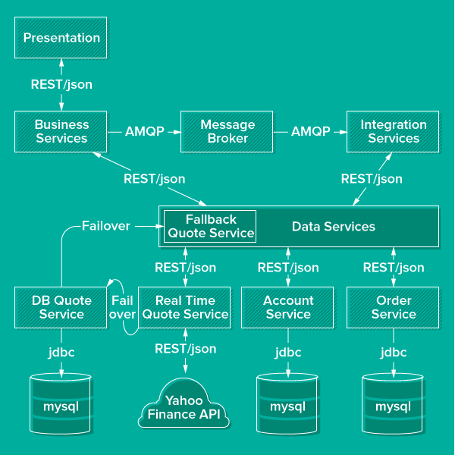

Slide 36

Break

